Slide 1

Predicting Mortgage Loan Default
BIT 5534: GROUP 10
DANNY LEAL AND EVERETT JOHNSON
Notes:
This presentation is a summary of the methods we used to predict whether a borrower will default on their mortgage loan.

Slide 2
BUSINESS PROBLEM
Sun City Bank, a smaller regional bank, is looking to identify which high-risk loans are prone to default. Our team is responsible to find ways to identify variables and patterns that could potentially impact loan default. By establishing this system, Sun City Bank can take a more risk aversion approach in loan origination thus reducing its future loan default rate.
Notes:
Banks generate much of their revenue by originating loans to borrowers and selling the loans in the secondary market or by servicing the loan and directly receiving interest from the mortgage payments in return. Securitized mortgage loans are seen as a very safe investment for banks as the value of homes generally rises and the safer the loan originated the more valuable it is in the secondary market. Also, most borrowers eventually take advantage of the equity generated in their homes or refinance their current mortgage for a better rate. However, not all loans make the bank money because borrowers may miss payments or default on their mortgage loans. Banks must have an extensive application review process to determine loan eligibility as a risky borrower could lead to the bank losing revenue on the loan. A borrower is then considered defaulted on their loan after 180-days or 3 missed payments.
Since borrower defaults represent a loss of revenue for banks, it is in the banks’ best interest to mitigate these losses. Banks should continue to fine tune their systems that predict applicant's potential to default on their mortgages.

Slide 3
BUSINESS OBJECTIVE
Our teams primary business objective is to leverage existing data of current borrower credit profiles to identify predictive variables of loan defaults to consistently adjust future loan approval criteria.
By using utilizing the new system, our team can identify and offer current borrowers loss prevention services earlier to alleviate burdens. Offering loss prevention earlier may lead to mitigating the loss in revenue and riskiness of the loan.
Notes:
Our team’s primary focus is to adjust the variables of our current model that predicts our applicants propensity to default, thus mitigating loan defaults our bank would otherwise would’ve originated. The banks reliance on this new system is very important for its growth as it plans to primarily sell A to AAA credit rated Mortgage Backed Securities (MBS) in the secondary market for a premium.
Along with this more risk averse loan origination approach, the bank is also looking to help its current borrowers with loss prevention services. Identifying these borrowers earlier will immediately prevent the loss of revenue from a loan default. It will also strengthen the bank’s credibility on its loan origination and will be an attributing factor in the bank’s plans for profitability and growth from a small regional bank to a larger multi-state or global bank.

Slide 4


QUESTIONS
Utilizing the borrower credit history in a mortgage loan application, will a potential borrower default on their loan?
Are there identifiable input variables that have a big impact or influence in predicting borrower outcomes more than others?
Notes:
Our main question to answer after building our models is will this applicant default on their mortgage loan based on the current variables in their credit profile. By asking ourselves this main question, we can achieve our main goal of predicting defaults with the given information in the applicant credit profile.
Another interesting question is, are identifiable input variables that have a big impact or influence in predicting customer outcomes more than others. We would like to determine which variables are more consistent with the prediction of our target variable the most.

Slide 5
DATA SET DESCRIPTION
RAW DATA SET
189,131 Observations
21 independent variables
78% did not default
22% defaulted
CLEANED DATA SET
78,850 Observations
15 independent variables
50% did not default
50% defaulted
Notes:
Our data is being sourced from the Federal Housing Finance Agency, we will be utilizing the latest Single-Family Mortgage data as it is the most common type of mortgage. With over 8 million records, the dataset was fairly large for our use so we decided to randomly select 25% of the data to create our sample size. This raw data set consisted of 189,131 observations and had 21 independent variables, including the target variable “default” which is a binary target that indicates if the borrower defaulted.
Because the data was imbalanced where we saw that 78% of the observations record as not defaulted and 22% record as defaulted, we utilized balancing techniques to get to an even 50/50 split. Additionally, we ran a stepwise regression for further dimension reduction where we reduced the inputs from 21 variables to 15 variables.

Slide 6
Data Dictionary
Field Name | Data Type | Description
active_loans | CONTINUOUS | Number of Active Loans
avg_account_age | CONTINUOUS | Average Loan length in months
credit_history_length | CONTINUOUS | Length of Credit History in months
credit_score | CONTINUOUS | Credit Bureau Score
credit_score_category | ORDINAL | Credit Score Description
cust_age | CONTINUOUS | Age of Customer
defaulted | NOMINAL | Loan Defaulted (0=No, 1=Yes)
delinquent_acccounts | CONTINUOUS | Number of Delinquent Accounts
employment_type | CONTINUOUS | Employment (Salaried, Self Employed, Not Applicable)
home_cost | CONTINUOUS | Cost of Home
loan_to_value | CONTINUOUS | Loan to Value on Home
new_recent_accounts | CONTINUOUS | Number of new accounts opened last 6 months
num_overdue_accounts | CONTINUOUS | Number of overdue accounts (180 days)
number_of_accounts | CONTINUOUS | Number of open lines of credit
number_of_inquiries | CONTINUOUS | Number of inquiries on Credit

Slide 7
MODELING
TECHNIQUES USED
CLASSIFICATION TREE
NOMINAL LOGISTIC REGRESSION
NEURAL NETWORK

Slide 8
MODEL RESULTS
 | R2 | RASE | Sensitivity | Specificity
Nominal Logistic Regression | 0.028 | .4902 | .533 | .643
Classification Tree | 0.024 | .4917 | .664 | .495
Neural Network | .032 | .4889 | .635 | .536

Slide 9
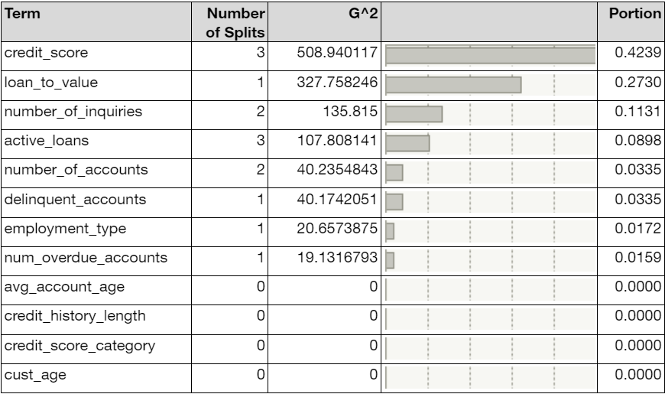
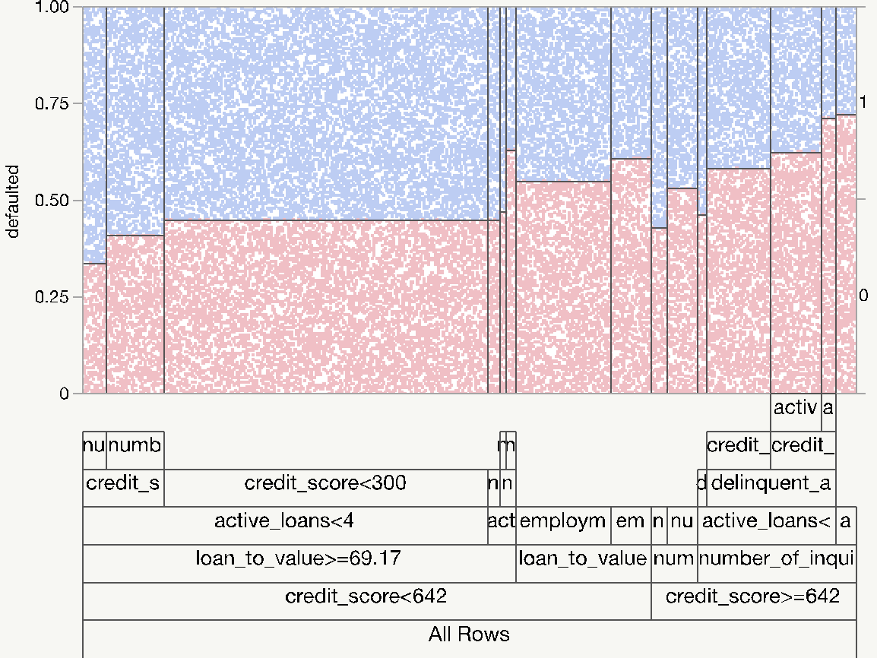
CLASSIFICATION TREE
Actual | Predicted Rate
defaulted | 0 | 1
0 | 0.495 | 0.505
1 | 0.336 | 0.664

Slide 10
NOMINAL LOGISTIC REGRESSION
Measure | Training | Validation | Definition
Entropy RSquare | 0.0283 | 0.0313 | 1-Loglike(model)/Loglike(0)
Generalized RSquare | 0.0512 | 0.0566 | (1-(L(0)/L(model))^(2/n))/(1-L(0)^(2/n))
Mean -Log p | 0.6735 | 0.6715 | ∑ -Log(ρ[j])/n
RASE | 0.4902 | 0.4891 | √ ∑(y[j]-ρ[j])²/n
Mean Abs Dev | 0.4808 | 0.4798 | ∑ |y[j]-ρ[j]|/n
Misclassification Rate | 0.4165 | 0.4121 | ∑ (ρ[j]≠ρMax)/n
N | 39426 | 39426 | n
Actual | Predicted Rate
defaulted | 1 | 0
1 | 0.643 | 0.357
0 | 0.467 | 0.533

Slide 11
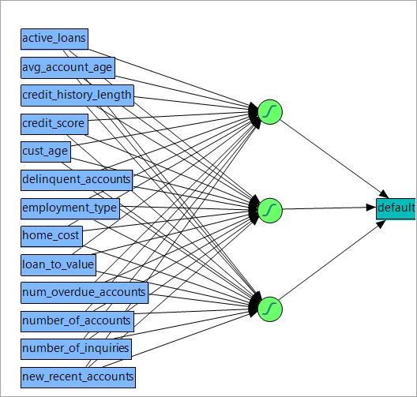
NEURAL NETWORK
Measures | Value
Generalized RSquare | 0.0582015
Entropy RSquare | 0.0321957
RASE | 0.4889472
Mean Abs Dev | 0.4791122
Misclassification Rate | 0.414422
-LogLikelihood | 26447.962
Sum Freq | 39426
Actual | Predicted Rate
defaulted | 0 | 1
0 | 0.536 | 0.464
1 | 0.365 | 0.635

Slide 12
Conclusions
Of the three nonlinear models our team produced to determine which could produce the best results, our group has determined the Neural Network model was best suited. The Neural Network model will actively adjust its weights through each iteration and poised for a large set of application and borrower data to continuously provide its deep learning algorithm to improve its prediction accuracy.
We understand that at each neuron we may not know how each independent variable is weighted however, due to the amount of data Sun City bank will be utilizing this model for, we decided that the neural network is best suited for the large amount of data. We also have determined that should there be any changes or additions in variables the neural network is better suited to handle the complex relationships at each perceptron.

